Slide 1
PARALLEL PROGRAMMING. TPL

Slide 2
AGENDA
TPL Introduction
Task Creation
Task Properties
Working with Task
Continuation Task
Class Parallel
Cancellation Token
Useful Links

Slide 3
TPL INTRODUCTION
TPL (Task Parallel Library)
allows to parallelize tasks and execute them on several processors at once
Every task can be created as instance of the Task class from System.Threading.Tasks namespace.

Slide 4
TASK CREATION
The 1-st way:
Creation new Task object with delegate Action as a parameter.
Start() method starts the created task.

Slide 5
TASK CREATION
The 2-nd way:
Using static method Task.Factory.StartNew(). It creates new task and runs it.

Slide 6
TASK CREATION
The 3-rd way:
Using static method Task.Run(). It creates new task and runs it.
This method also can take delegate Action as a parameter.

Slide 7
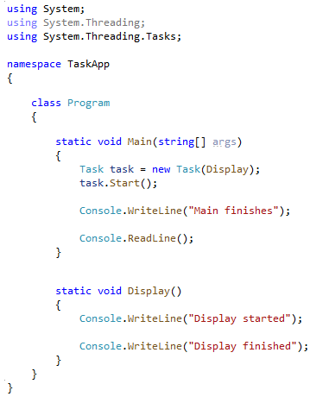

EXAMPLE

Slide 8
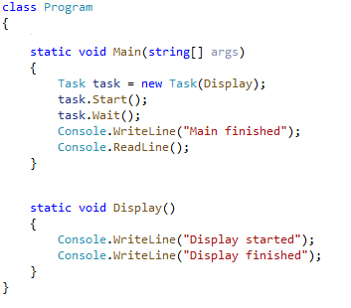

WAIT()
Method Wait() is used if task execution should start when the main code is already executed.

Slide 9
TASK PROPERTIES
AsyncState
Returns state of the task
CurrentID
Returns identifier of the task
Exception
Returns exception that occurred while task was executing
Status
Returns state of the task

Slide 10
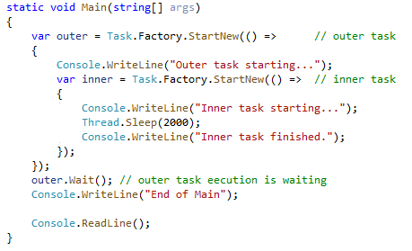

WORKING WITH TASK
Task can be started by another task.
Both tasks will be executing independently.

Slide 11
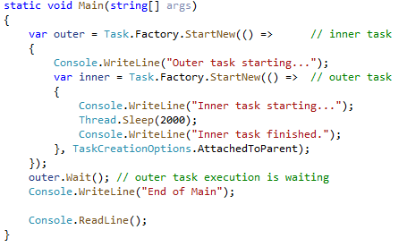

WORKING WITH TASK
To execute the inner task along with the outer one. TaskCreationOptions.AttachedToParent should be used.

Slide 12
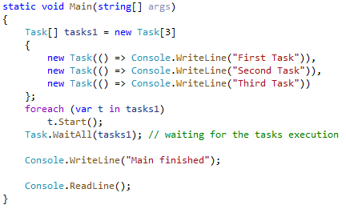

TASKS ARRAY
A few tasks can be added to array.
Task.WaitAny(tasks) waits while at least one task will be finished.

Slide 13
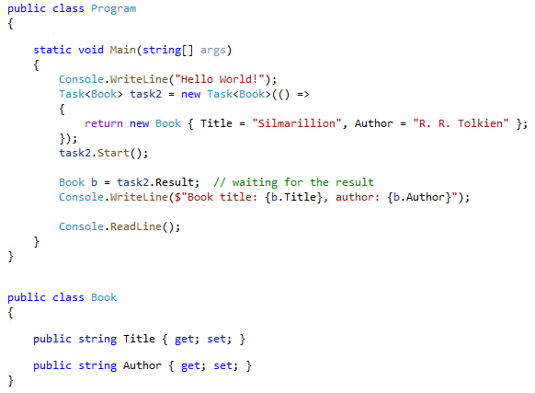

TASK RESULT
Some tasks can return the result.

Slide 14
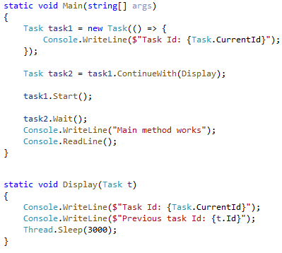

CONTINUATION TASK
Continuation tasks start execution after the other tasks completed.

Slide 15
SLASS PARALLEL

Slide 16
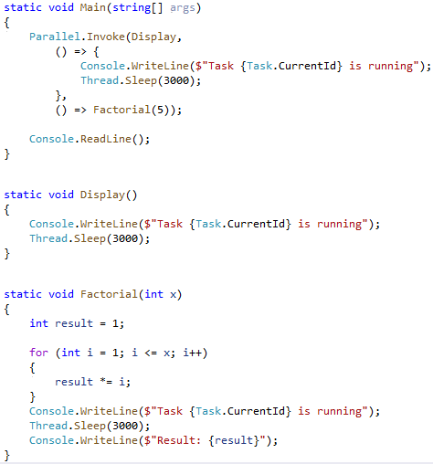

PARALLEL.INVOKE
Parallel.Invoke() method takes an array of Action objects as parameter and runs tasks.

Slide 17
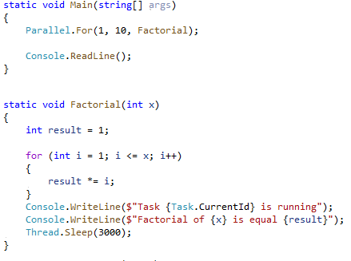
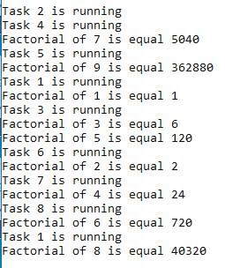
PARALLEL.FOR
Parallel.for() allows the parallel execution of loop iterations.

Slide 18
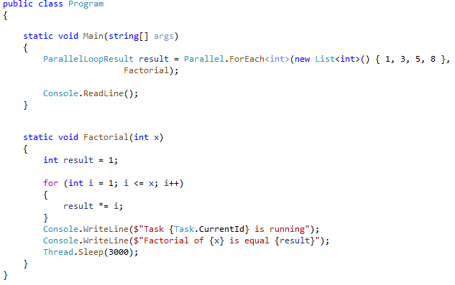
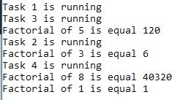
PARALLEL.FOREACH
Method Parallel.Foreach() works similarly to foreach loop for collections. It allows the parallel tasks execution.

Slide 19
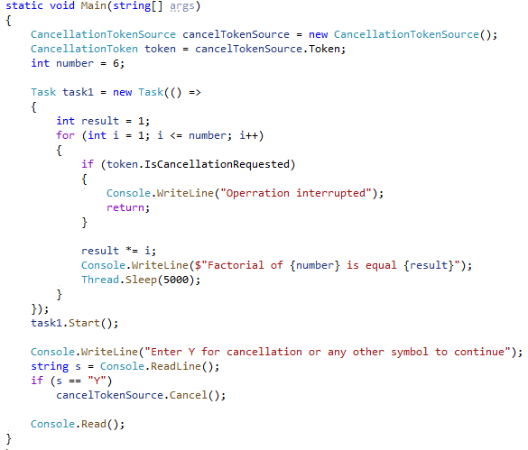
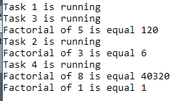
CANCELLATION TOKEN
To interrupt the executing task Cancellation Token should be used.

Slide 20
USEFUL LINKS
https://docs.microsoft.com/en-us/dotnet/api/system.threading.tasks.task?view=netcore-3.1
https://docs.microsoft.com/en-us/dotnet/api/system.threading.tasks.parallel?view=netcore-3.1
https://codewithshadman.com/csharp-task/

Slide 21


